Slide 1

Natural computing applied to population genomics
Oscar Lao
oscar.lao@cnag.crg.eu
31.01.2020

Slide 2


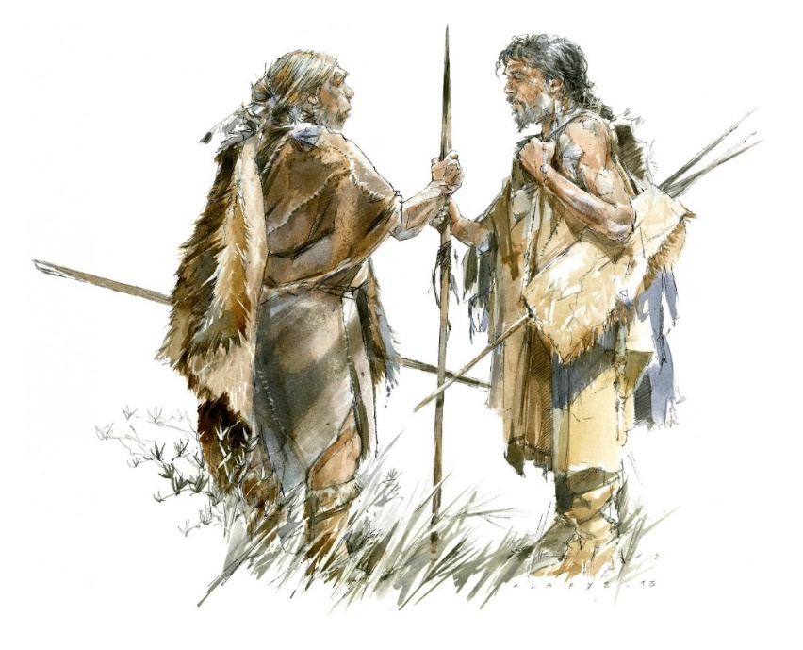


ENIGMA
STOCK MARKET
DATING
LOSE WEIGHT
MATING WITH ARCHAICS
FIND A JOB

Slide 3
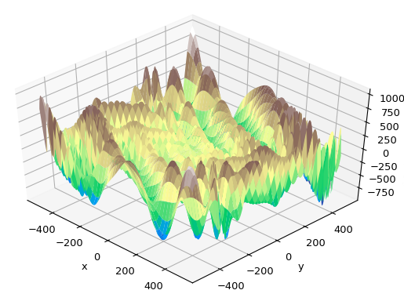
FOR A COMPLEX PROBLEM
UNKNOWN FUNCTION SHAPE
COMPLEX FUNCTIONS
NP-HARD PROBLEM

Slide 4

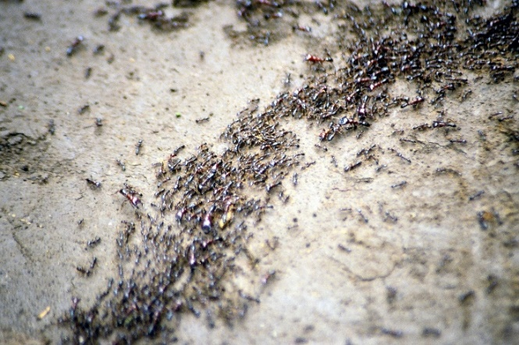
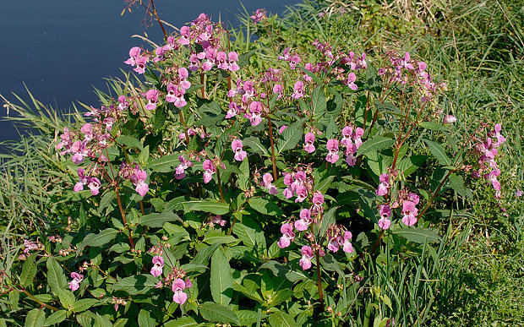
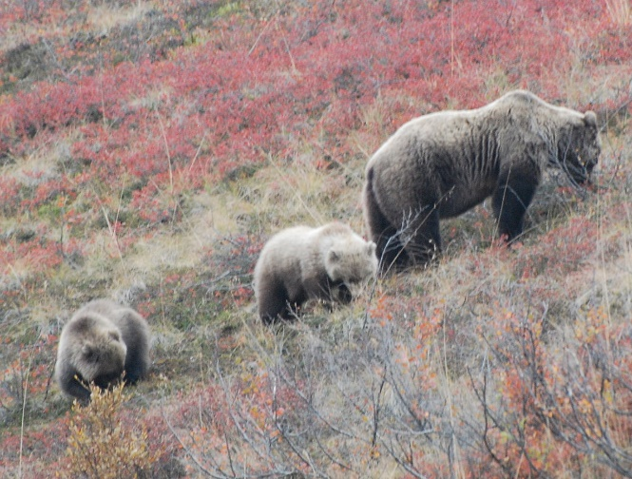
NATURAL SOLUTIONS
SWARMS
ANT COLONY
INVASIVE WEED
FORAGING

Slide 5

NATURAL COMPUTING

Slide 6
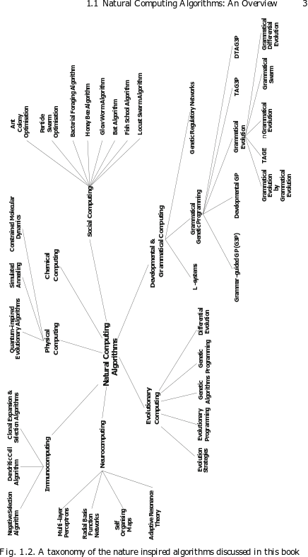
NATURAL COMPUTING

Slide 7
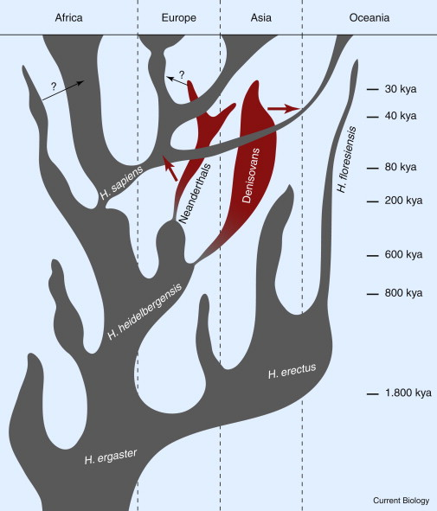
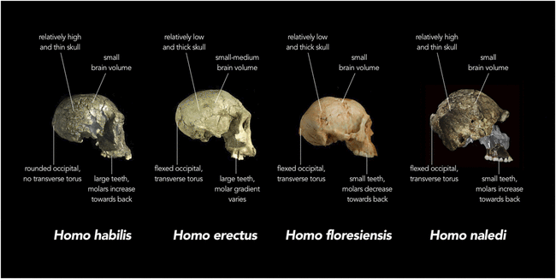
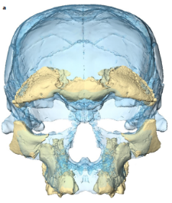
HUMAN EVOLUTION: COMPLEX & CONSTANTLY REVISITED
Nature Hubblin 2017
H. erectus dmanisi
Stringer, 2015
H. erectus ergaster
Current Biology, 21 (24), 2011, R1002–R1009

Slide 8
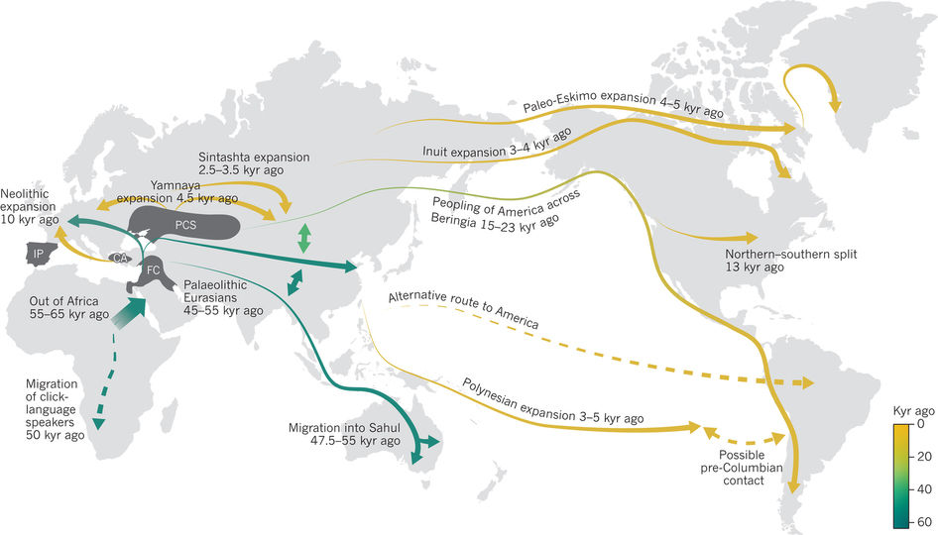
HUMAN EVOLUTION: OUT OF AFRICA
Nature. 2017;541(7637):302-310

Slide 9

HUMAN EVOLUTION: INBREEDING WITH NEANDERTHAL
1-4%
Homo neanderthalensis
Homo sapiens

Slide 10
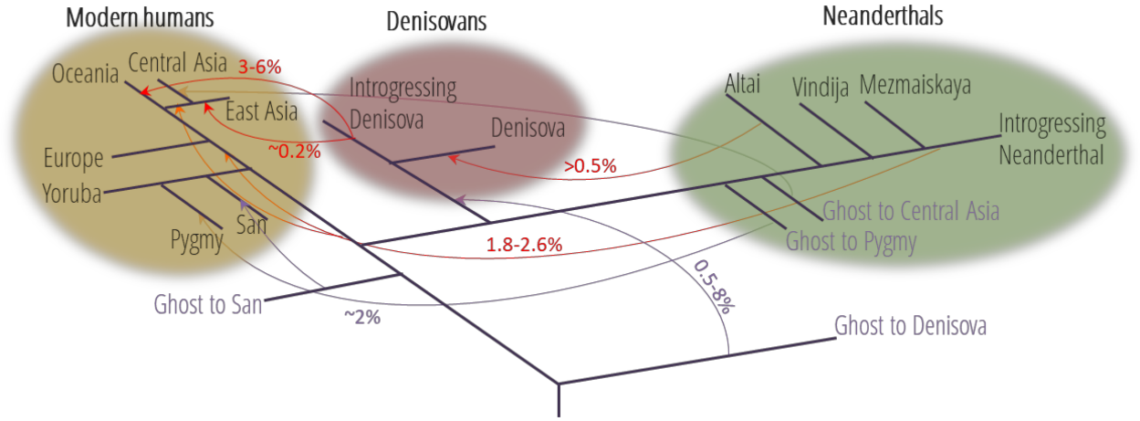
HUMAN EVOLUTION: INBREEDING WITH GHOST POPS
Dolgova and Lao; Genes 2018, 9(7), 358; https://doi.org/10.3390/genes9070358

Slide 11
DEMOGRAPHIC INFERENCE
MODEL ASCERTAINMENT
PARAMETER ESTIMATION
A
B
C
P(D|Μ) ?
P(D|θ) ?
ATGCATGGGCTATTGGACCT
ATGGATGGGCTATTGCACCT
ATGCATGGGCAATTGCACCT
ATGCATGGGCAATTGGACCT
ATGGATGGGCTATTGCACCT
A
B
C

Slide 12
APPROXIMATE BAYESIAN COMPUTATION (ABC)
Simulate data
Estimate summary statistics (SS)
Compare with observed SS
Retain simulation parameters given ε threshold

Slide 13
APPROXIMATE BAYESIAN COMPUTATION (ABC)
Simulate data
Which simulator?
Estimate summary statistics (SS)
Which SS?
Compare with observed SS
Which Distance?
Retain simulation parameters given ε threshold
Which threshold?

Slide 14
ABC: THE SUMMARY STATISTIC PROBLEM
  How do you define “informative” SS for θ?
    Previous experience given the same or similar models
    The SS correlates with θ
  Redundancy (Not a problem in theory)
    Redundant SS can bias the posterior (in practice…)
      More severe with low number of simulations
    How to control?
      Apply algorithms for removing redundant SS
      Combine SS (i.e. PCA)

Slide 15
ABC: THE SUMMARY STATISTIC PROBLEM
  How do you define “informative” SS for θ?
    Previous experience given the same or similar models
    The SS correlates with θ
  Redundancy (Not a problem in theory)
    Redundant SS can bias the posterior (in practice…)
      More severe with low number of simulations
    How to control?
      Apply algorithms for removing redundant SS
      Combine SS (i.e. PCA)

Slide 16
ABC: THE SUMMARY STATISTIC PROBLEM
  How do you define “informative” SS for θ?
    Previous experience given the same or similar models
    The SS correlates with θ
  Redundancy (Not a problem in theory)
    Redundant SS can bias the posterior (in practice…)
      More severe with low number of simulations
    How to control?
      Apply algorithms for removing redundant SS
      Combine SS (i.e. PCA)
How could we identify the most informative Summary statistic of the data?

Slide 17
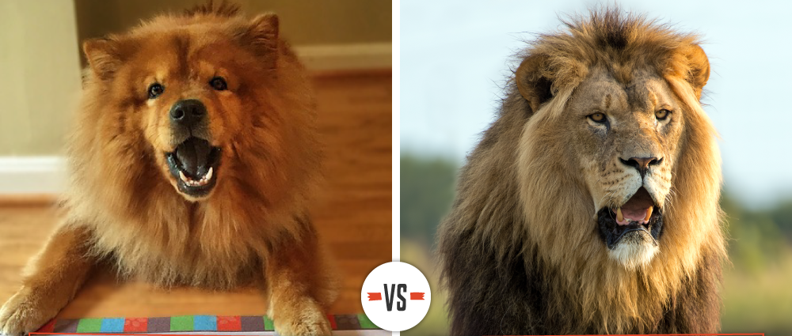
NATURAL SOLUTIONS
Not really dangerous
If you come close, you can guess my next dinner…
PATTERN RECOGNITION

Slide 18
The perceptron: the neuron as a model for processing information
NATURAL INSPIRATION TO OPTIMIZE

Slide 19
INFERENCE OF EVOLUTIONARY HISTORY
APPROXIMATE BAYESIAN COMPUTATION (ABC)
DEEP LEARNING (DL)
Simulate data
Estimate summary statistics (SS)
Compare with observed SS
Retain simulation parameters given ε threshold

Slide 20
ARTIFICIAL NEURAL NETWORK
Learning algorithm
Topology
Training size
Overfitting
Dropout
Notes:
A two hidden Deep learning model. Black circles correspond to bias units. The output of the Deep learning network is the probability of assignation to one of the models. This probability will be used as summary statistic at the ABC analysis.

Slide 21

GARBAGE in, GARBAGE out

Slide 22






TRAINING (ARTIFICIAL) NEURAL NETWORK IN PRACTICE

Slide 23
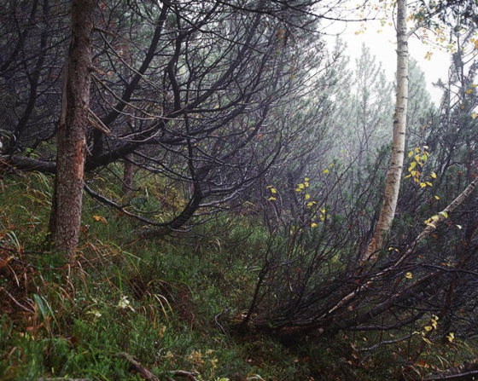
TRAINING (ARTIFICIAL) NEURAL NETWORK IN PRACTICE
http://simonmenner.com/pages/1Camouflage.htm
There is a sniper in this image pointing at you right now

Slide 24

ARTIFICIAL NEURAL NETWORK
Learning algorithm
Topology
Training size
Overfitting
Noise injection
SFSi,js=(1-αi)SFSi,js+αiSFSi,jr
αi∈[0,0.2]
Dropout
Notes:
A two hidden Deep learning model. Black circles correspond to bias units. The output of the Deep learning network is the probability of assignation to one of the models. This probability will be used as summary statistic at the ABC analysis.

Slide 25
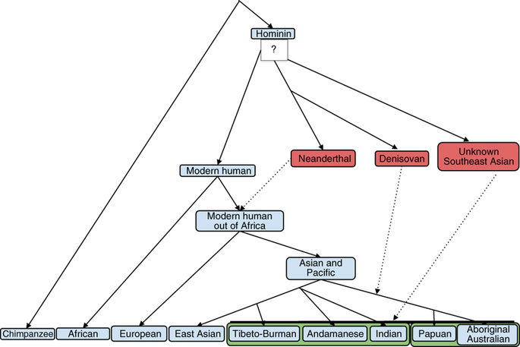
HUMAN EVOLUTION: ANCIENT HISTORY OF ASIA
Nat Genet. 2016;48(9):1066-70
WHEN DID IT APPEAR?
DOES THIS POPULATION EXIST?
WHICH IS THE AMOUNT
OF INTROGRESSION?

Slide 26
HUMAN EVOLUTION: ANCIENT HISTORY OF ASIA
P(M|D)
MODEL

Slide 27
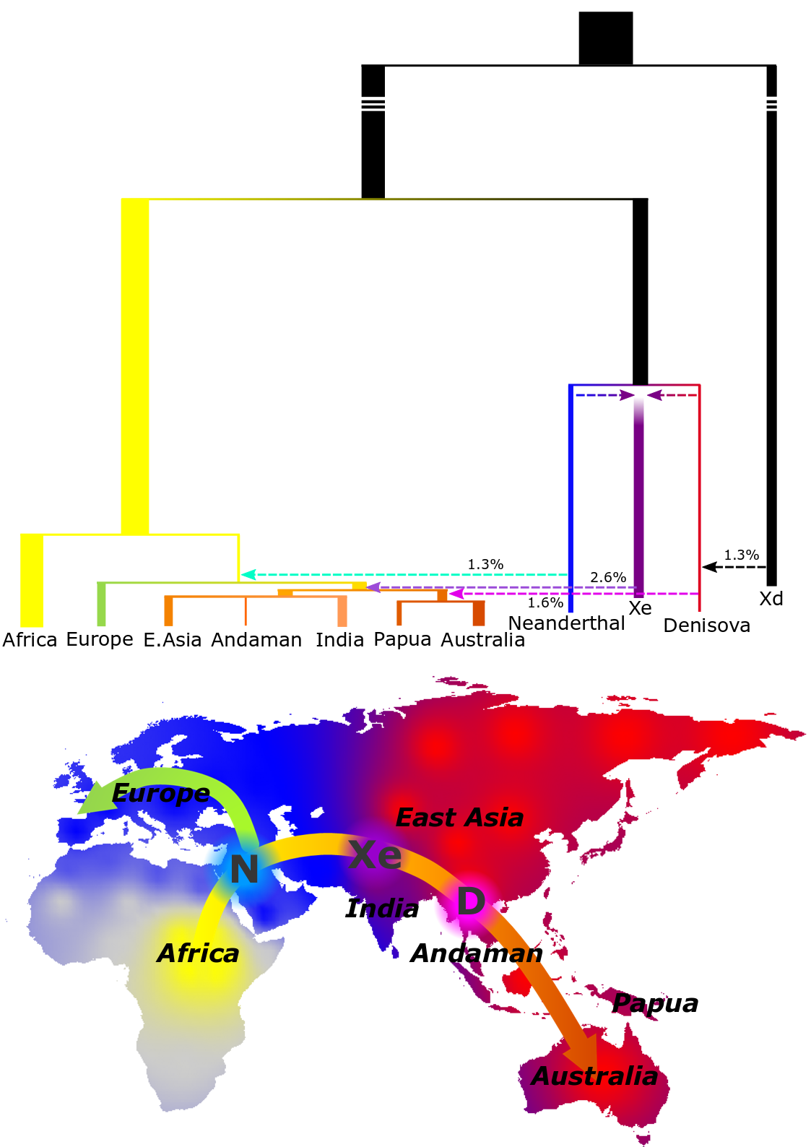
HUMAN EVOLUTION: ANCIENT HISTORY OF ASIA
Mondal, Bertranpetit and Lao, Nature Communications 2019

Slide 28
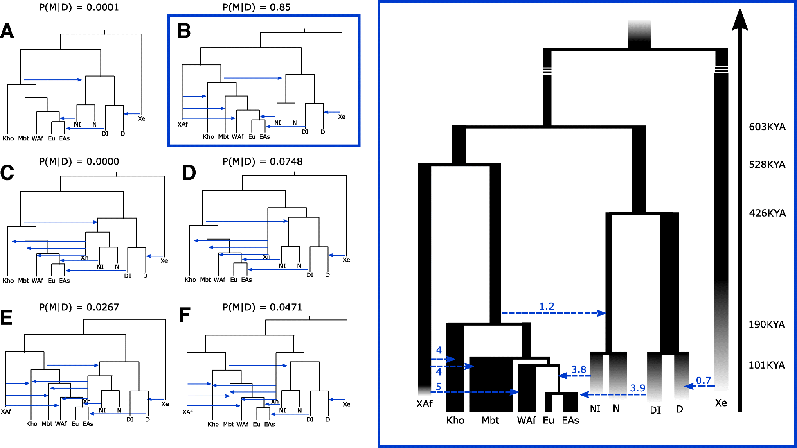
HUMAN EVOLUTION: ANCIENT HISTORY OF ASIA
Llorente-Galdos, Lao O, Serra Vidal et al, Genome Biology 2019

Slide 29
SPATIAL SFS
C
D
C
X
D
A
B
A
B

Slide 30
SPATIAL SFS
C
D
C
X
D
A
B
A
B

Slide 31
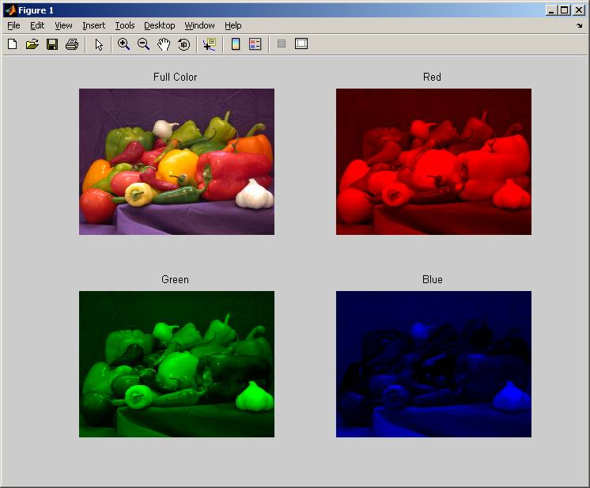
SPATIAL SFS
RGB image

Slide 32
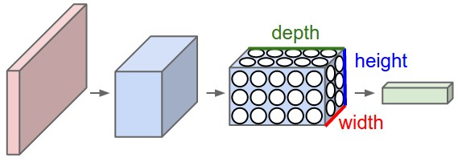
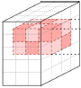
SPATIAL SFS
Deep of the layer = 3 (the 3 channels)
Height = X pixels
Weight = Y pixels
Red
Green
Blue

Slide 33
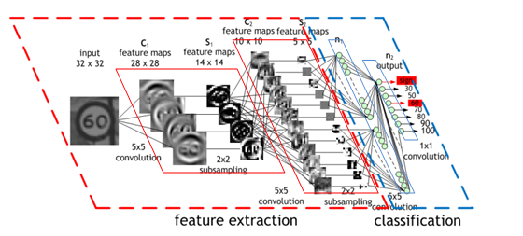
SPATIAL SFS

Slide 34
SPATIAL SFS
RGB image

Slide 35
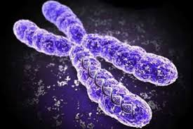
SPATIAL SFS
By analogy
SFS profile 0,0,0,…,0,1
SFS profile 0,0,0,…,0,2
…
SFS profile 1,2,2,…,2,2

Slide 36
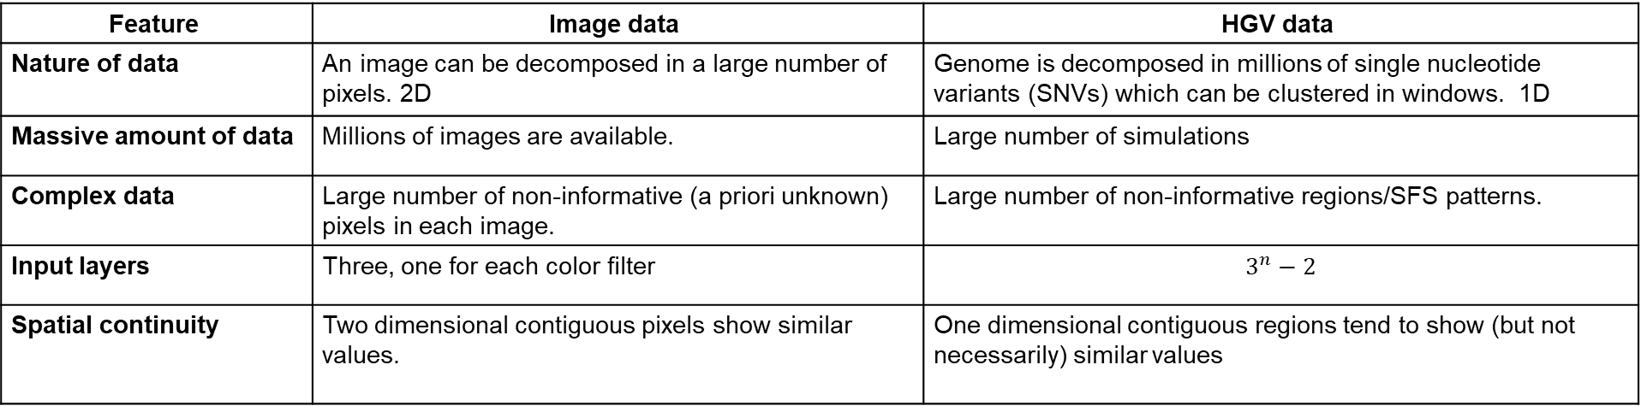
SPATIAL SFS
Feature | Image data | HGV data
Nature of data | An image can be decomposed in a large number of pixels. 2D | Genome is decomposed in millions of single nucleotide variants (SNVs) which can be clustered in windows. 1D
Massive amount of data | Millions of images are available. | Large number of simulations
Complex data | Large number of non-informative (a priori unknown) pixels in each image. | Large number of non-informative regions/SFS patterns.
Input layers | Three, one for each color filter | $$3^{n}−2$$
Spatial continuity | Two dimensional contiguous pixels show similar values. | One dimensional contiguous regions tend to show (but not necessarily) similar values

Slide 37
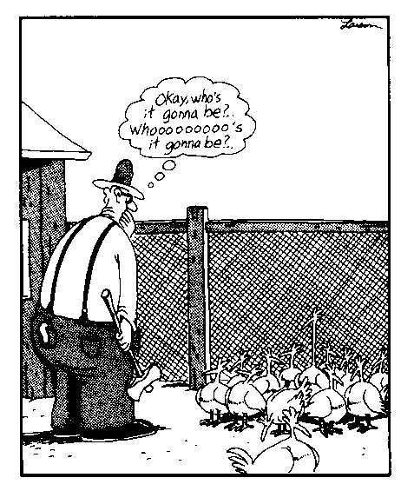
SPATIAL SFS
Which SFS profiles
Filters
Which activation functions
Population of μ answers
Reproduce asexually
each answer λ
with mutation ρ
K-neighbour error estimation
Next generation
Select best κ offspring
Select best μ answers

Slide 38
ABC-ESCNN
TRAINED BY MEANS OF EVOLUTIONARY STRATEGY
TRAINED BY MEANS OF CLASSICAL GRADIENT DESCENT

Slide 39
ABC-ESCNN
C
D
C
X
D
A
B
A
B
92 | 8
4 | 96
C
D
A
B
C
X
D
A
B

Slide 40
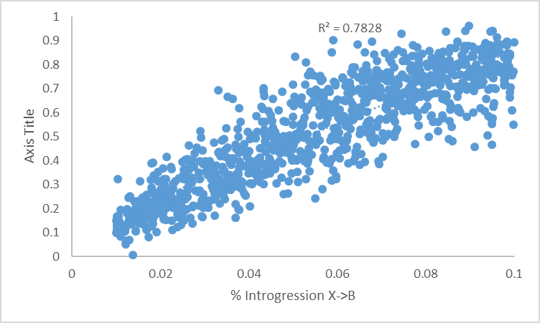
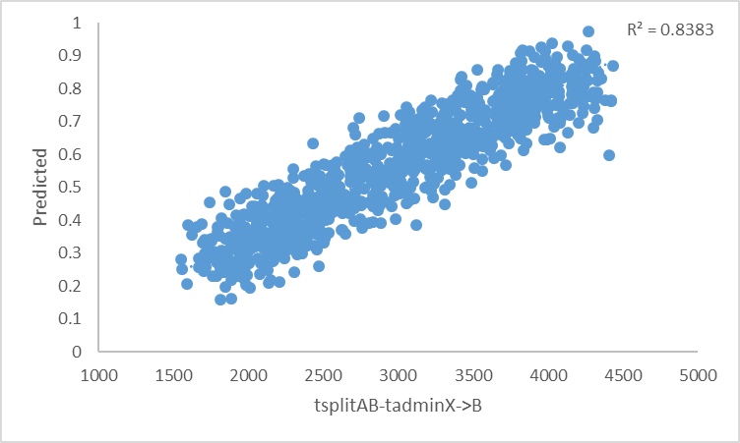
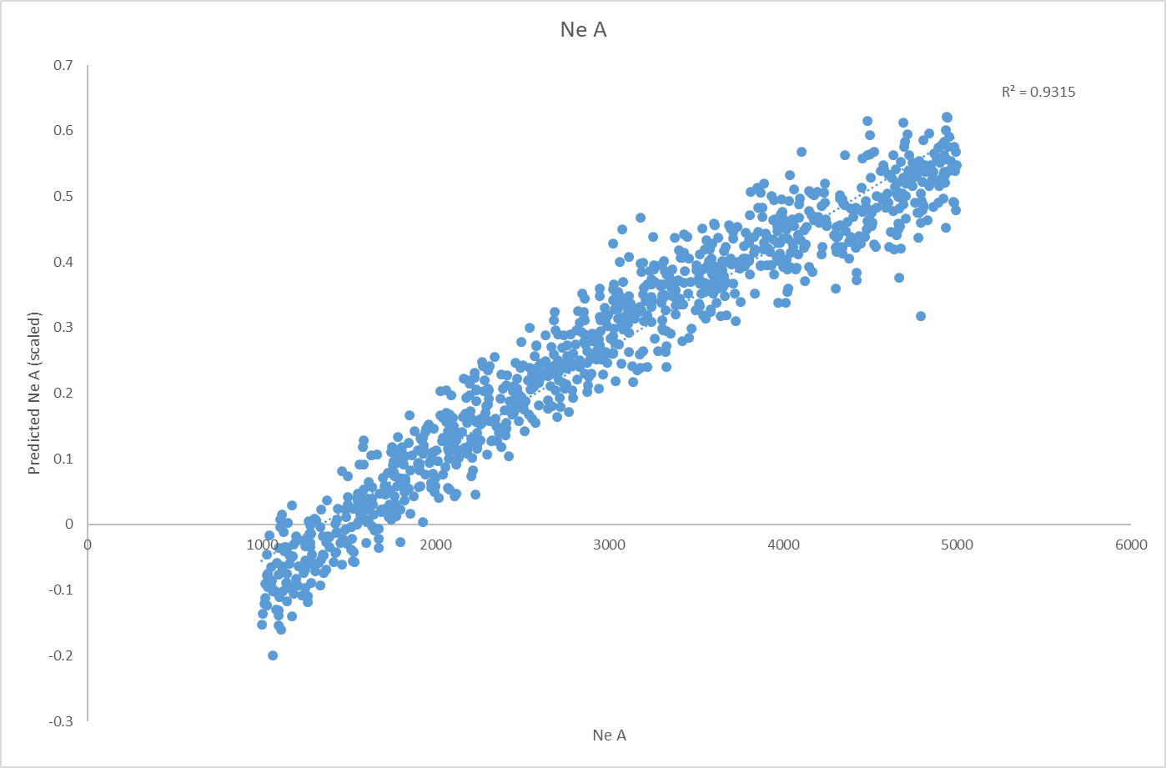
ABC-ESCNN
C
X
D
A
B

Slide 41
TAKE-HOME MESSAGES
Inferring evolutionary parameters from genetic data is complex
Natural computing as a tool for heuristically estimating demography
Many room for improvement
Many things still to discover!!!!!

Slide 42
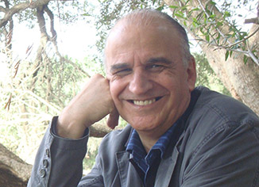



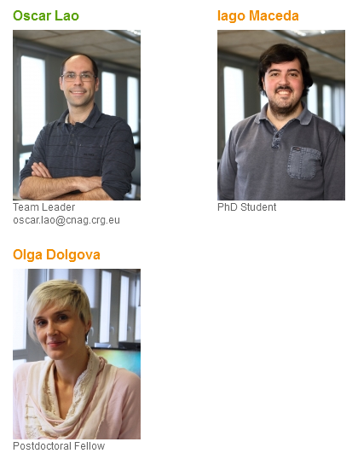


AKNOWLEDGEMENTS

Slide 43
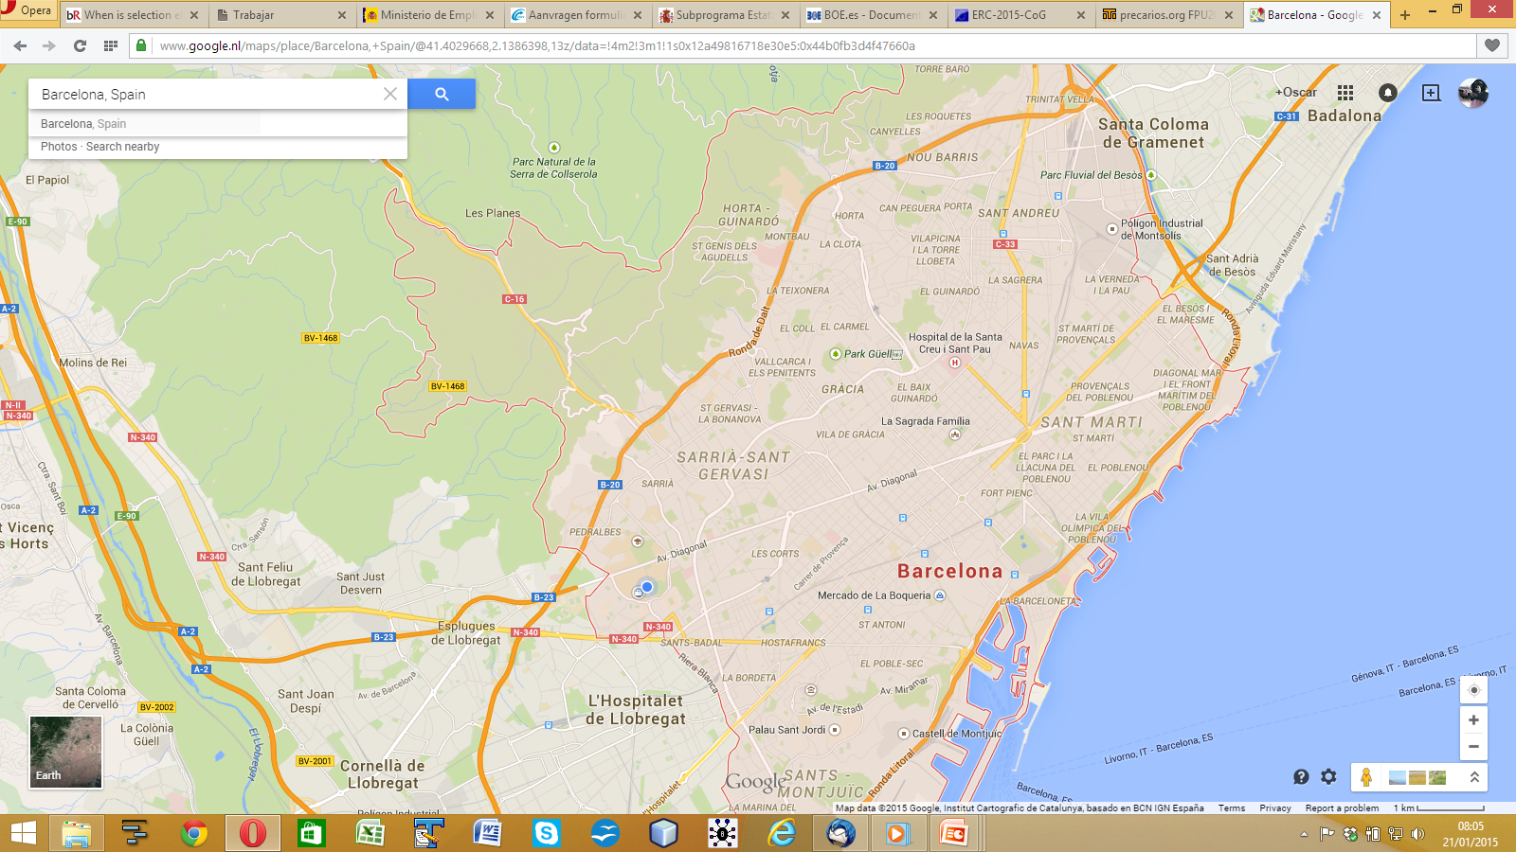

Thank you very much!
oscar.lao@cnag.crg.eu

